Slide 1
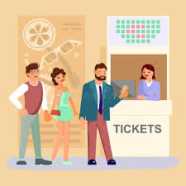
Museum Ticket Booking Bot
Team ID : RIT13
Team Members:
Immanuvel R
Jothi Sree R S

Slide 2
Abstract: Museum Booking Bot
The Museum Booking Bot is an intelligent, interactive system designed to streamline the process of booking museum tickets through a conversational interface. Developed using Node.js and integrated with a Telegram bot, the system enables users to explore and book tickets for various museums with ease.
The bot initiates the conversation by allowing the user to select a preferred language (English, Hindi, or Tamil), making it accessible to a diverse audience. It then offers options like "Book a ticket" or "Exit." If the user selects the booking option, the bot asks for relevant details such as the museum name or location, preferred date (within a 7-day range), session times, and the number of tickets. The system then allocates the available seats and confirms the booking by storing the user's phone number and booking information in a MongoDB database, tickets can be verified with unique ticket number. This project demonstrates the potential of using conversational bots to enhance user experiences by automating routine tasks like museum bookings, making the process faster and more accessible to users across different languages.

Slide 3

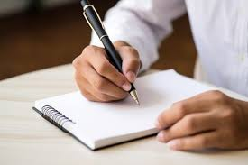
Problem
Indian culture is rich and it has lots of museums & monuments depicting it , but people are not much attracted to it and most of the time they are empty Till date, there is no familiar online booking system for museums making it even more unpopular among the people.
Visitors to museums often face several significant challenges due to manual ticket booking systems.
Long queues are common, especially during peak hours, weekends, or special exhibitions, leading to frustration and impatience among visitors.

Slide 4
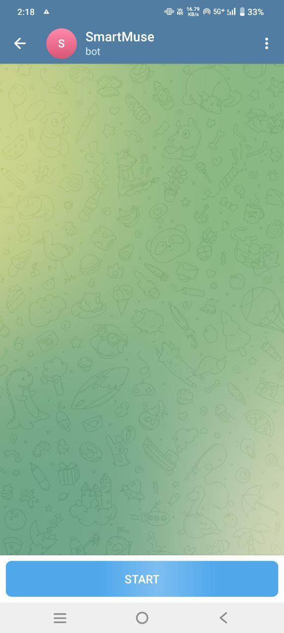
Solution
So we came up with an idea to increase the popularity of museums by introducing a bot , which can tell about the museums and also enables the user to book tickets for it using a telegram bot .
Enhance visitor satisfaction by reducing wait times, minimizing errors, and providing 24/7 customer support in multiple languages.

Slide 5
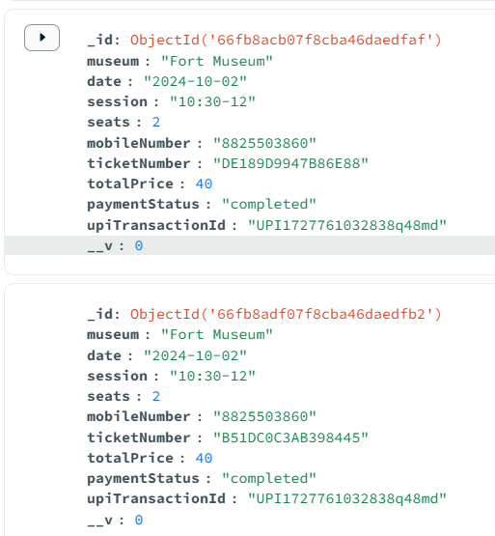
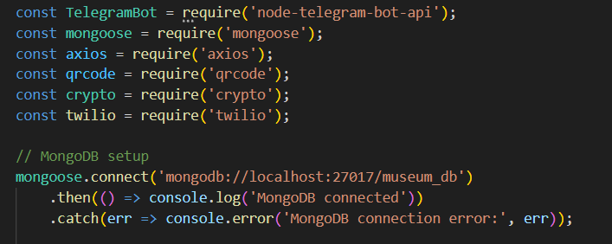
Tech Stack
Chatbot Framework: Telegram API
Backend Development: Node.js
Database: MongoDB

Slide 6
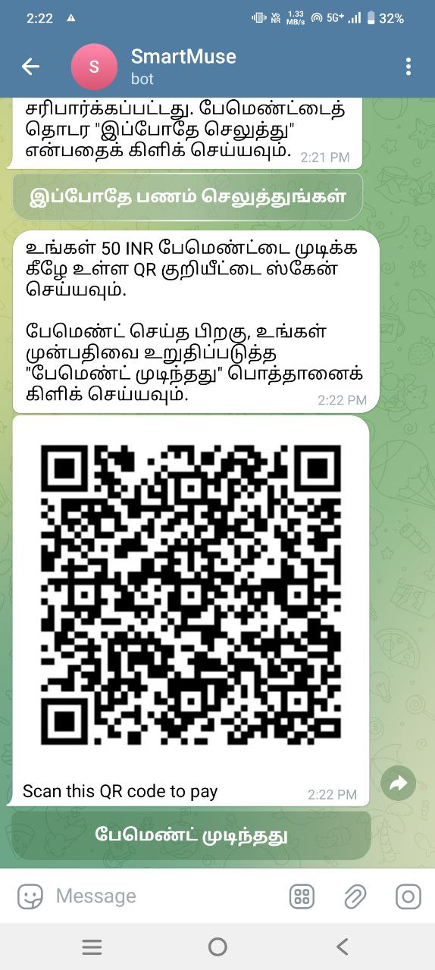
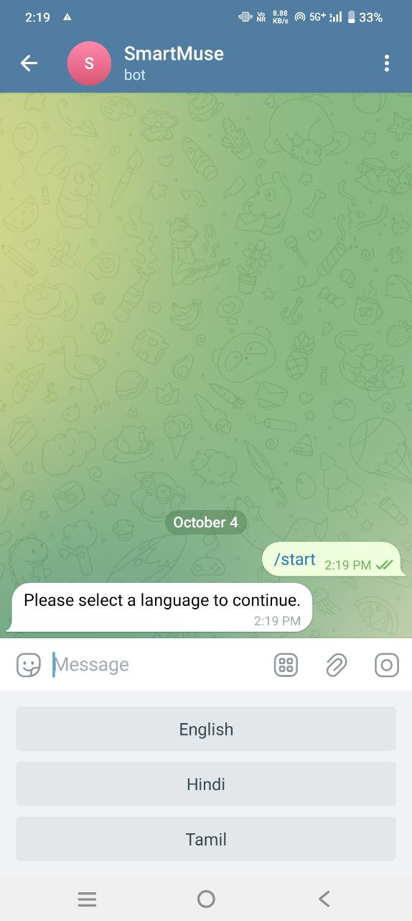
Tech Stack
Payment Gateway Integration: UPI
Admin UI: React , JavaScript
Multilingual Support: Memory API
Cloud Hosting: Render

Slide 7
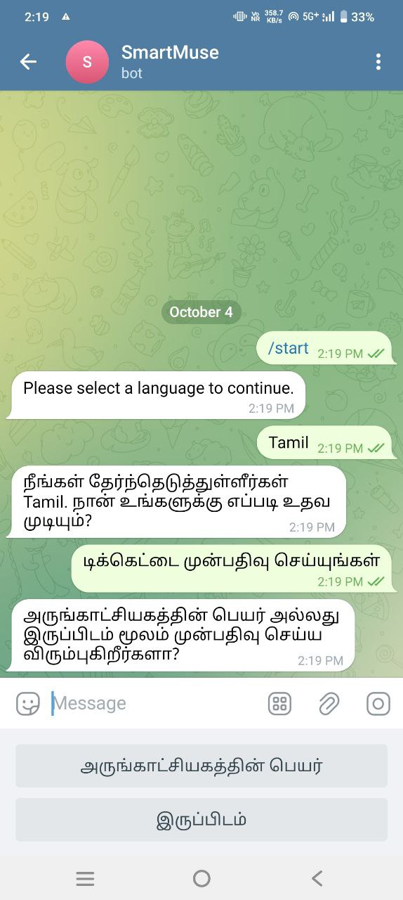
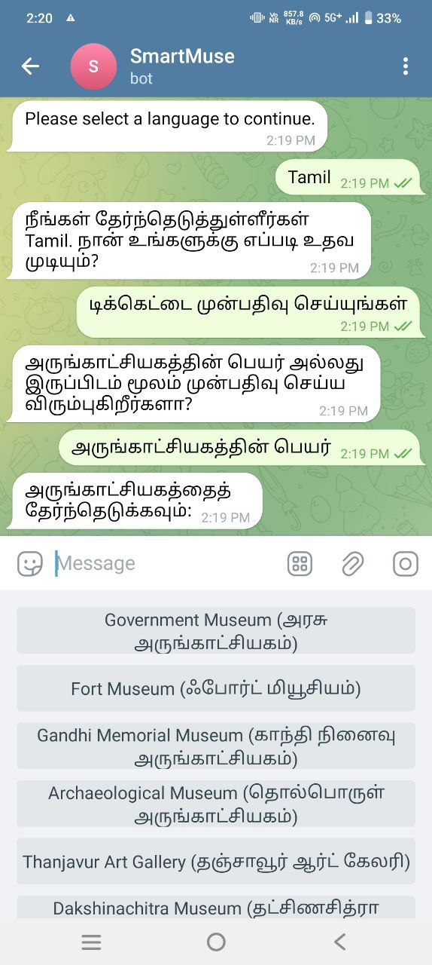
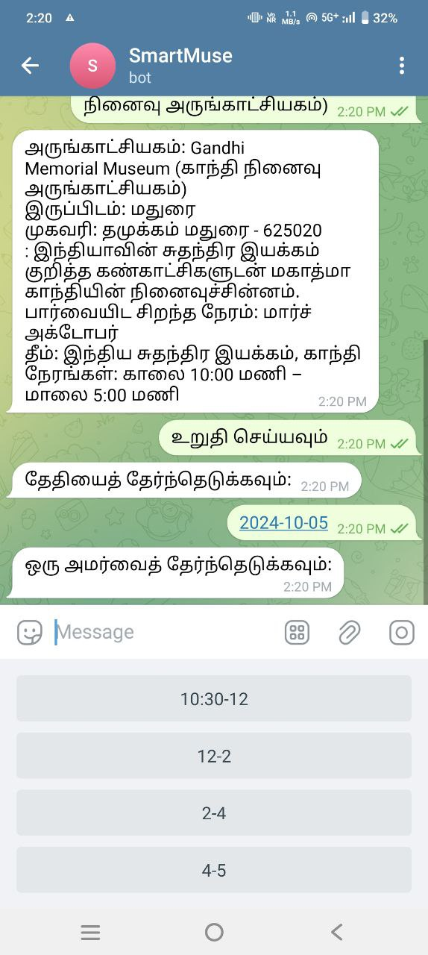
Features
Language selection
(English, Hindi, Tamil, Telugu)
Museum and date selection
Session time selection
Seat allocation
Confirmation and exit options

Slide 8
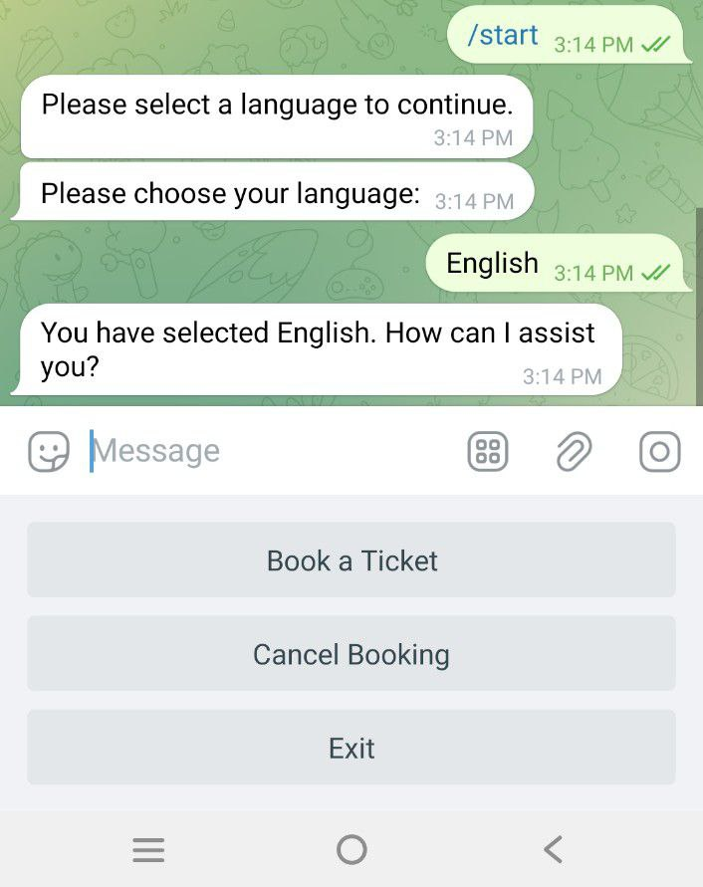
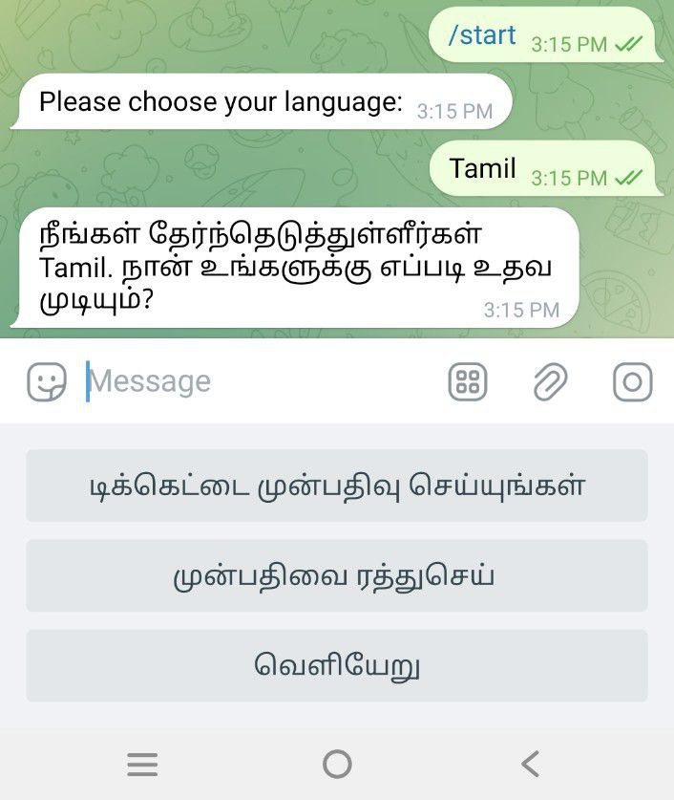
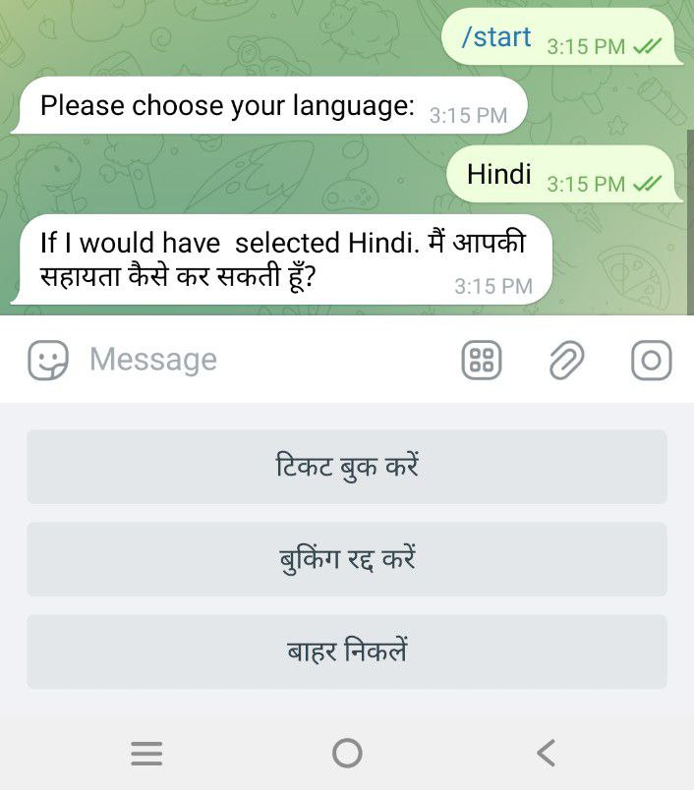
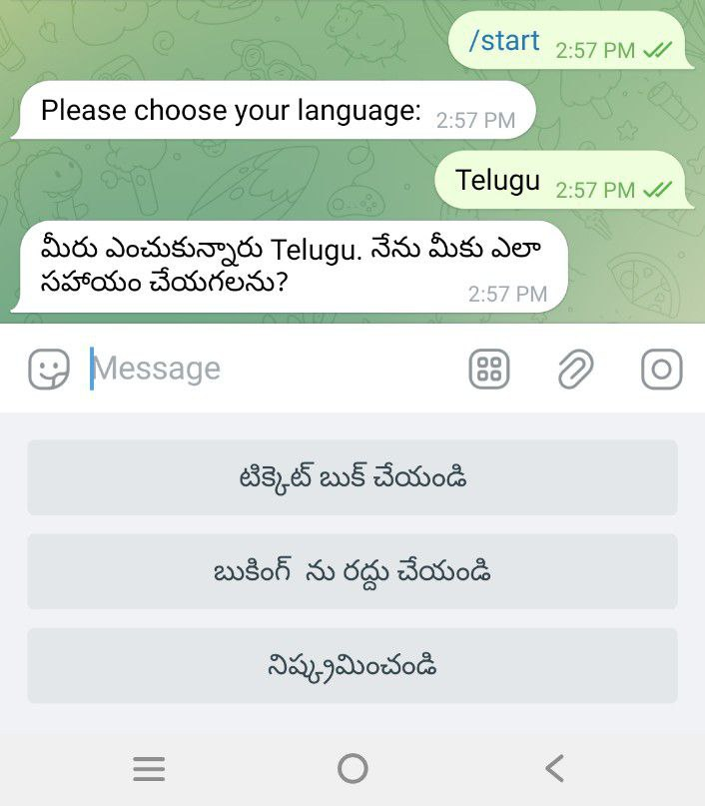

Slide 9
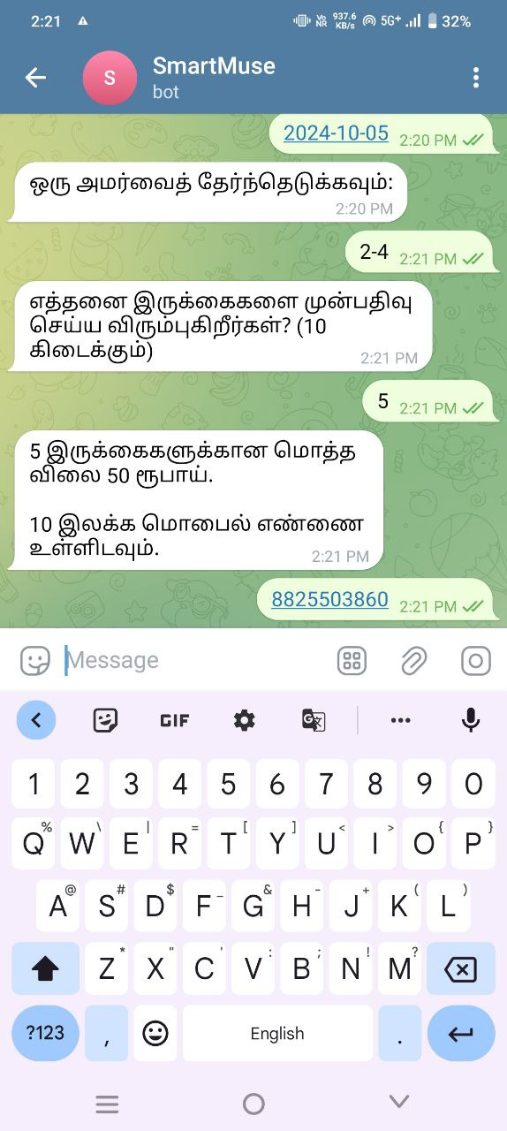
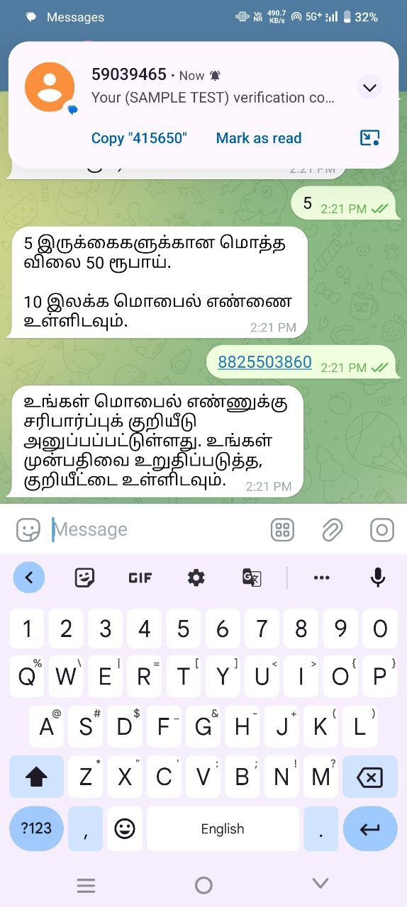
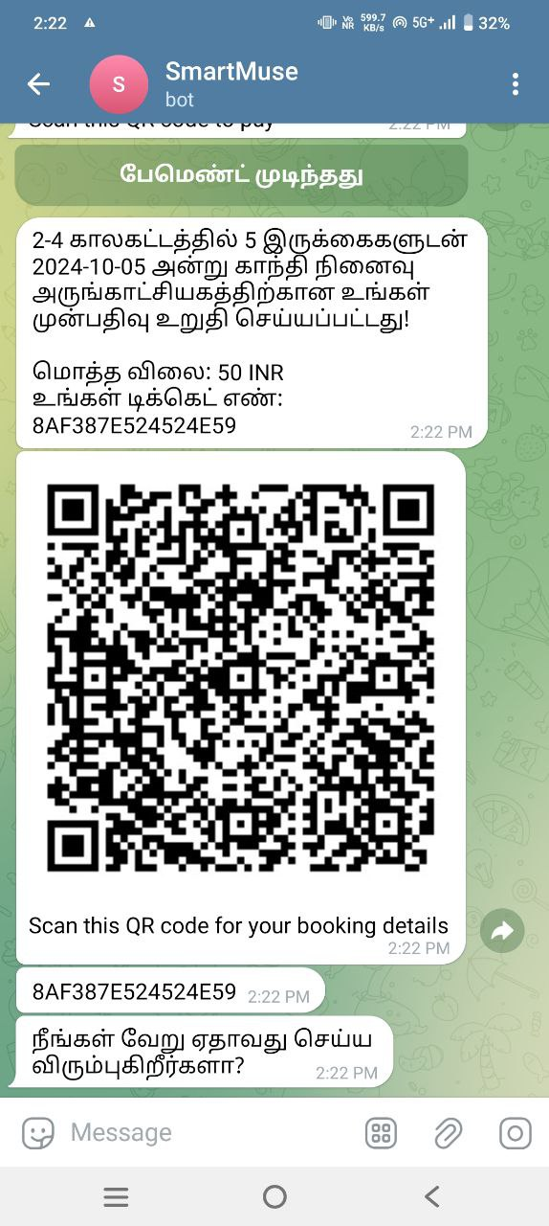

Slide 10
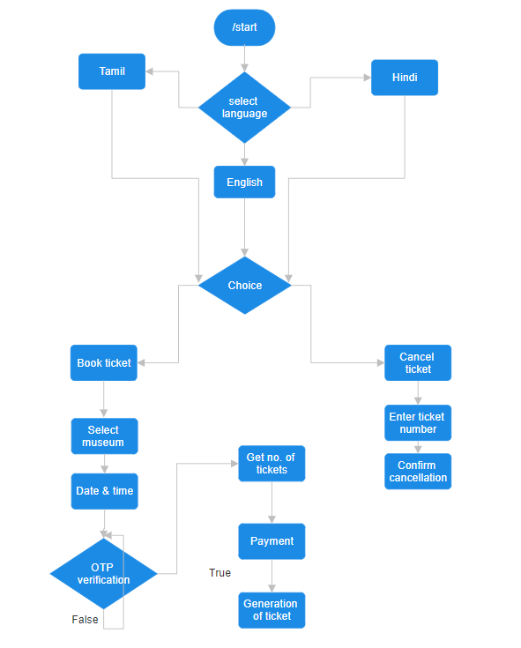
Flow chart

Slide 11
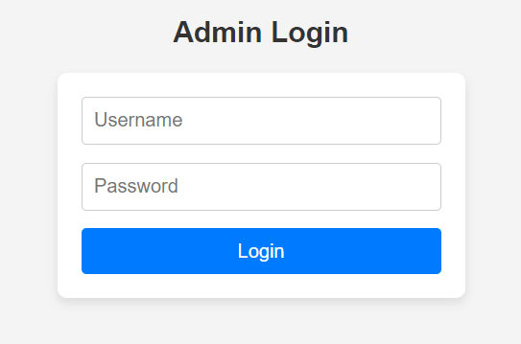
JWT USAGE FOR IMPROPER ACCESS

Slide 12
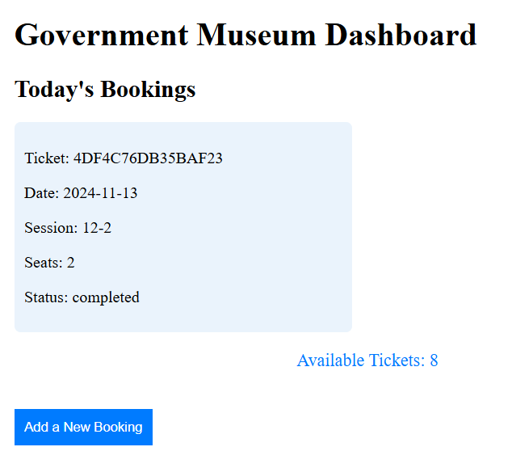
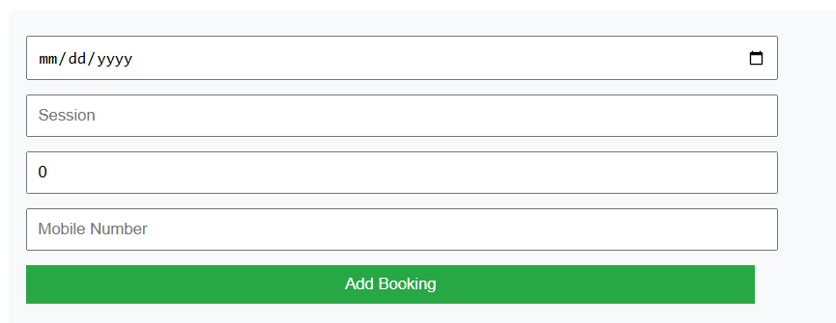

Slide 13
Prototype working video
Video Link

Slide 14
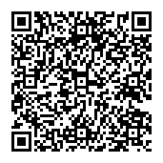
IMPACT AND BENEFITS
The chatbot ticketing system will make it easier and faster for visitors to book tickets, leading to higher satisfaction and potentially increasing the number of visitors to the museum.
Cuts down on paper usage by eliminating physical tickets, helping the museum be more eco-friendly.
Makes the museum more accessible to everyone, including non-English speakers and people with disabilities.
17C354AC182F4107

Slide 15
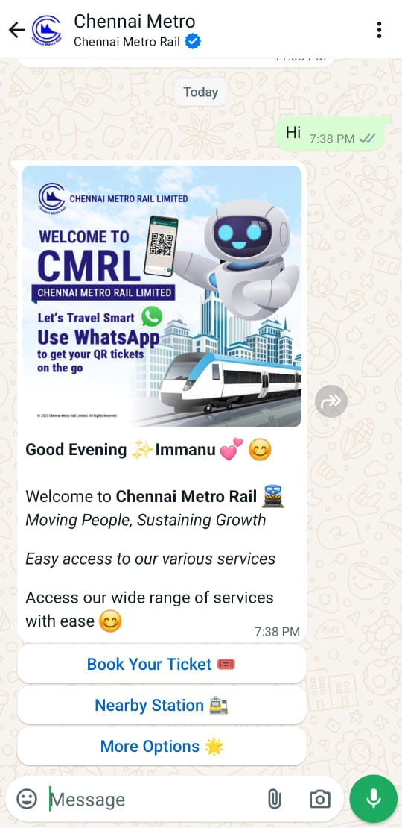
RESEARCH AND REFERENCES
https://youtu.be/F2-RuyIroFw?feature=shared
https://core.telegram.org/bots/api
https://react.dev/
https://www.twilio.com/docs
https://nodejs.org/docs/latest/api/

Slide 16
Conclusion
The Telegram bot enhances the museum ticket booking experience by providing a user-friendly interface and efficient booking process, which with specific marketing ways will end up in popularizing the museums among the Indians.

